Slide 1


GREEN UNIVERSITY OF BANGLADESH
ARFF Tree Explorer
Presented by: Presented to:
Md. Zehadul Islam - 222902069
Md. Abu Rumman Refat
Lecturer Dept. Of CSE
Green University Of Bangladesh
Md. Abdullah Al Moin - 222902070
01

Slide 2
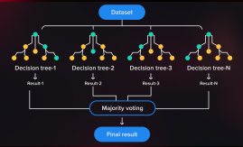
Introduction
What is ARFF Tree Explorer?
Objective of the project:
Main Goal
Load ARFF files
Generate decision trees
Visualize them interactively
[ARFF File]
[Parse Data]
[Train Tree]
[Generate DOT]
[Render Tree]
02

Slide 3

Algorithms Used
J48 Tree
REPTree
Decision Stump
Random Forest
LMT
03

Slide 4

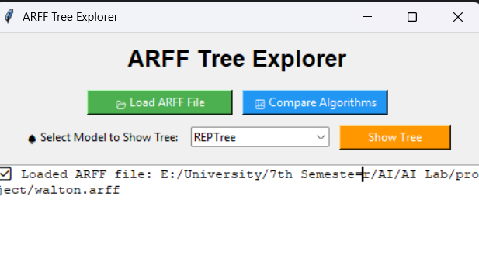

Interface
Load Arff File
Structure
Comparison
Show Tree
04

Slide 5
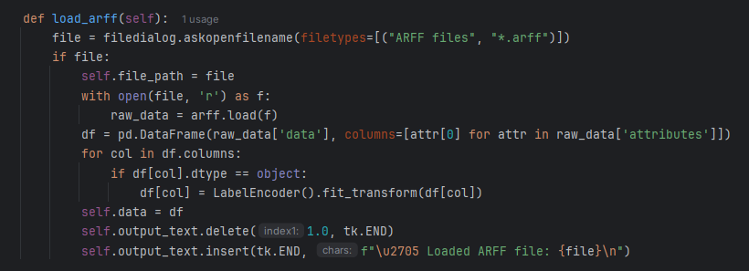

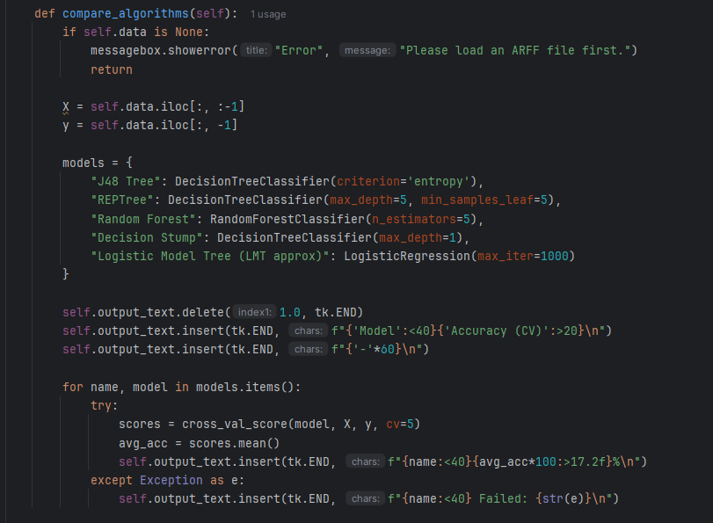
Code Logic
GUI allows users to select ARFF files using file dialogs.
Cross-validation is applied to multiple models.
05

Slide 6
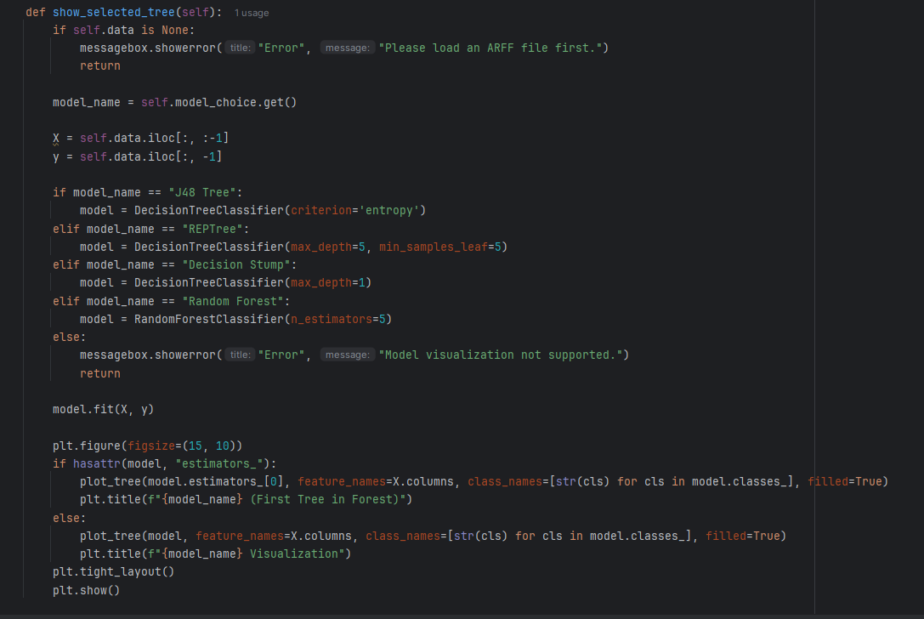
Code Logic
Displays trees explorer graphically using matplotlib.
06

Slide 7

Future Enhancements
Add CSV/Excel file support
Export results to PDF/image
Hyperparameter tuning options
Add confusion matrix and precision/recall metrics
07

Slide 8

Thank You
08

